Slide 1
AI Applications
Modern applications of Artificial Intelligence
Hamidreza Hosseinkhani
School of AI - 2018

Slide 2
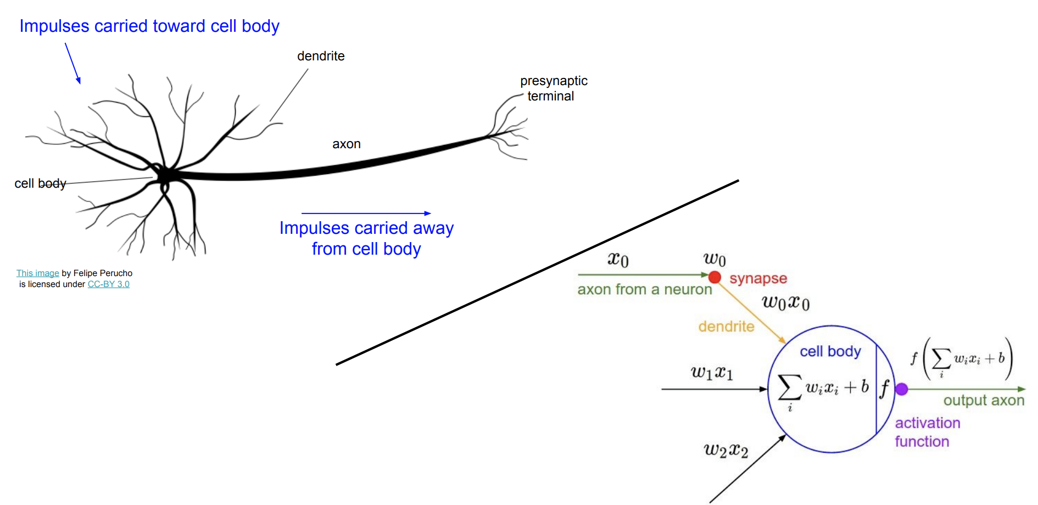
Artificial Neuron

Slide 3
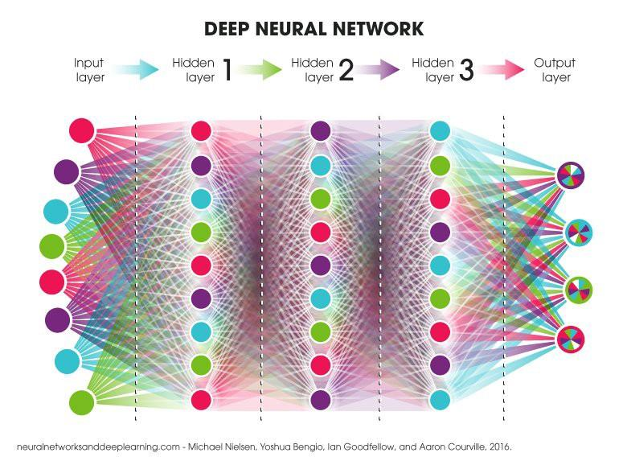
Artificial Neural Network - Deep Learning

Slide 4
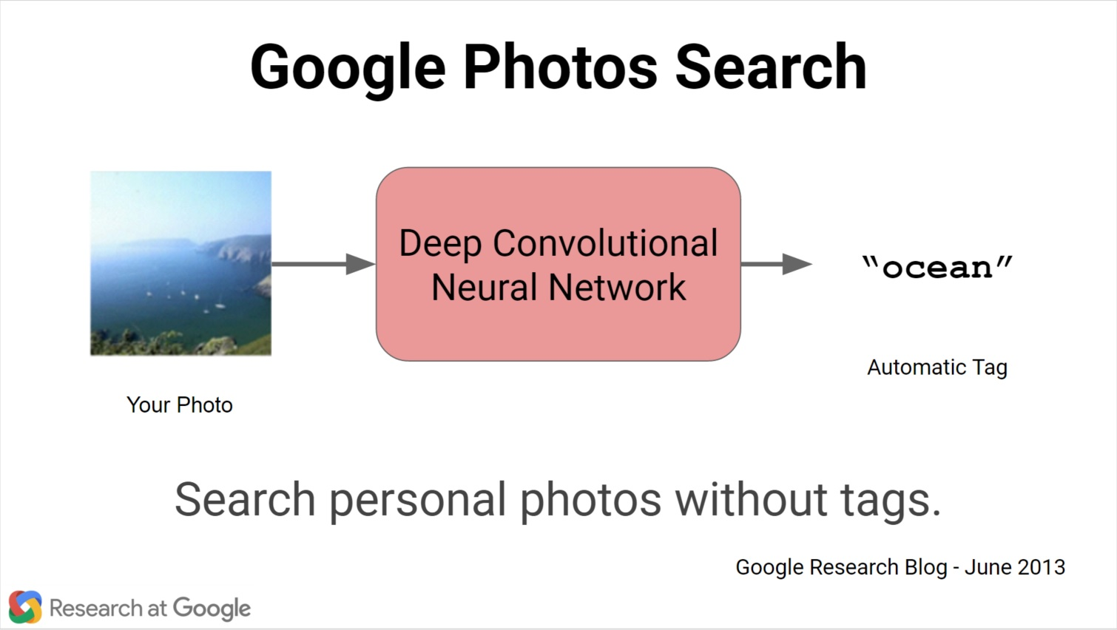
Automatic Image Tagging

Slide 5
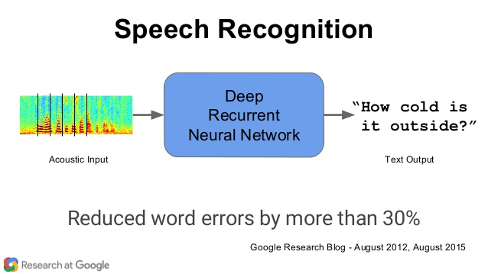
Speech to Text

Slide 6
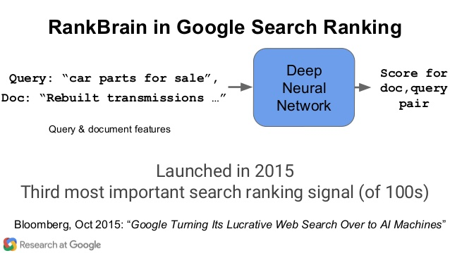
Page Ranking

Slide 7
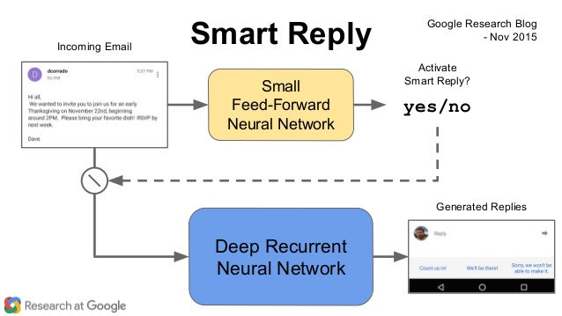
Auto Reply

Slide 8
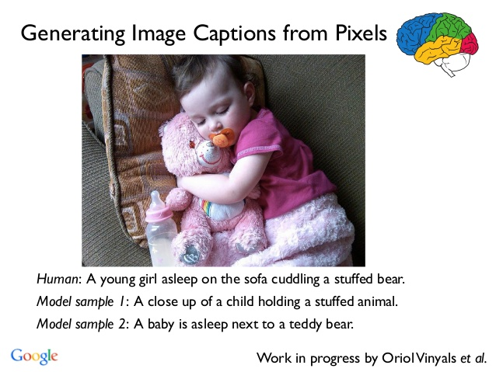
Image Captioning

Slide 9
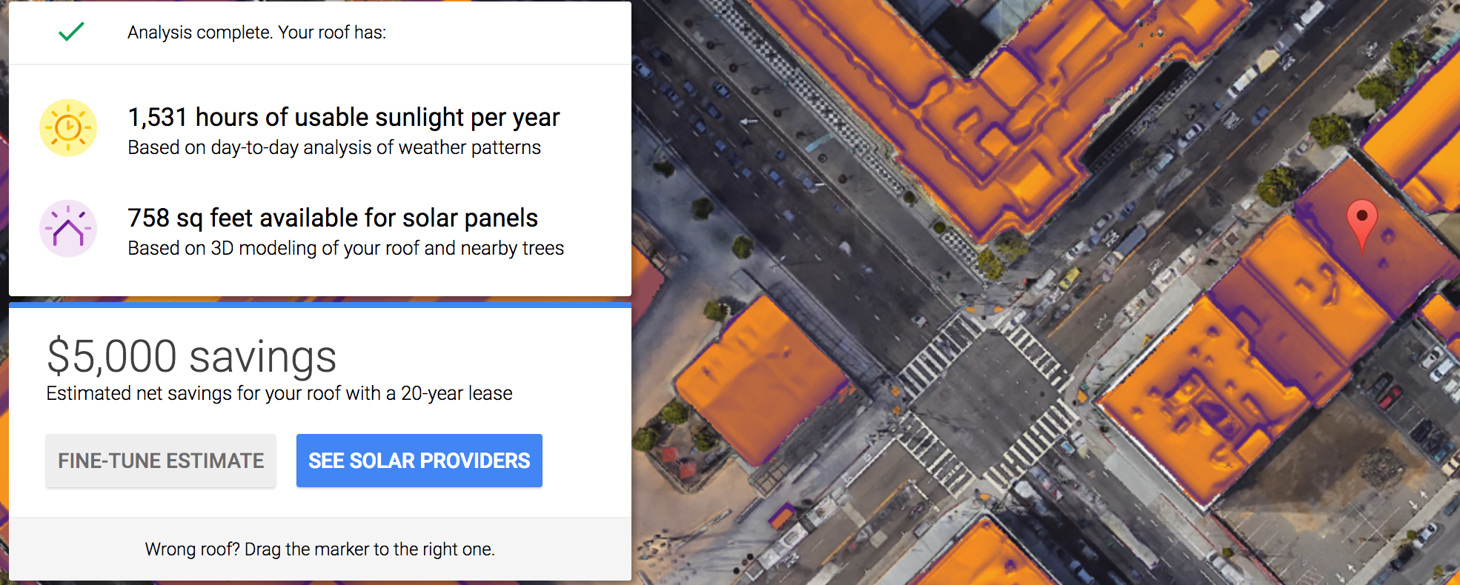
Estimate solar savings potential

Slide 10
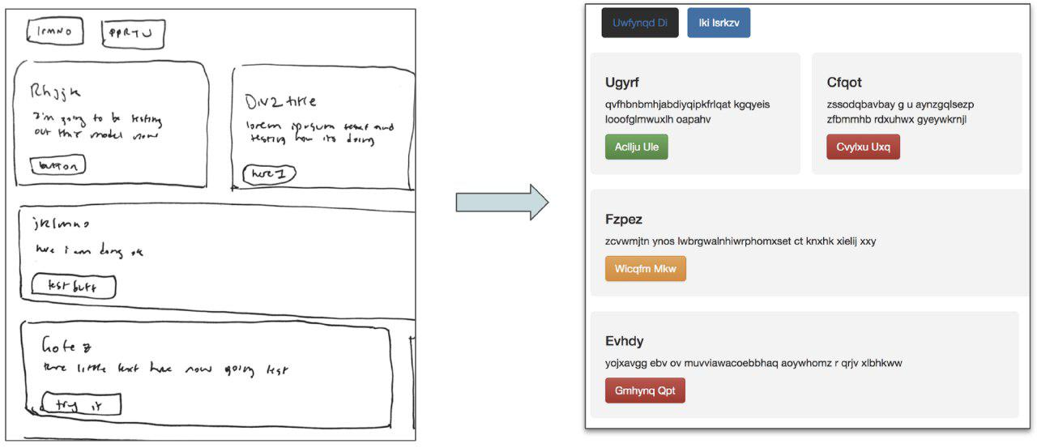
Front-end Development

Slide 11
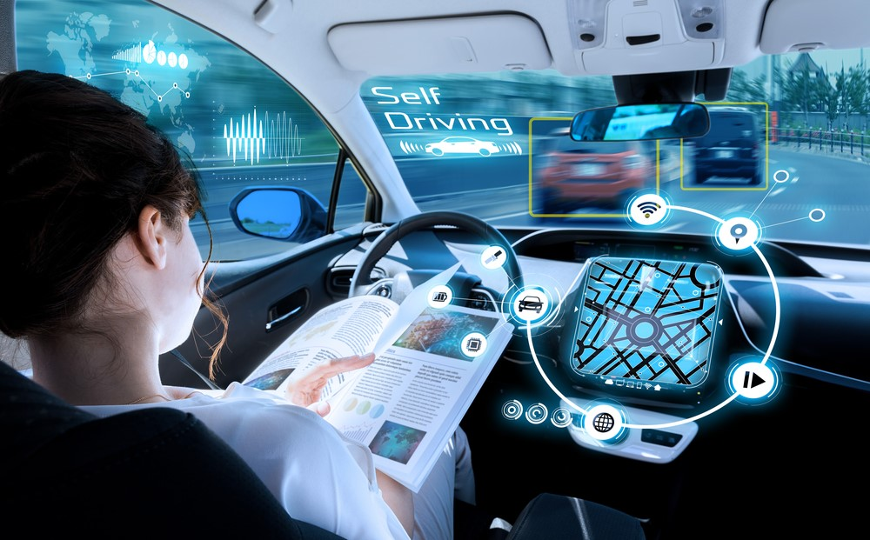
Self-driving Cars

Slide 12
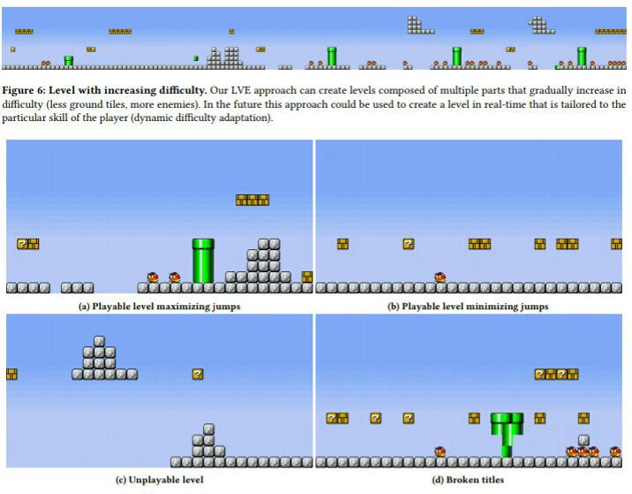
Generate New Game Levels

Slide 13
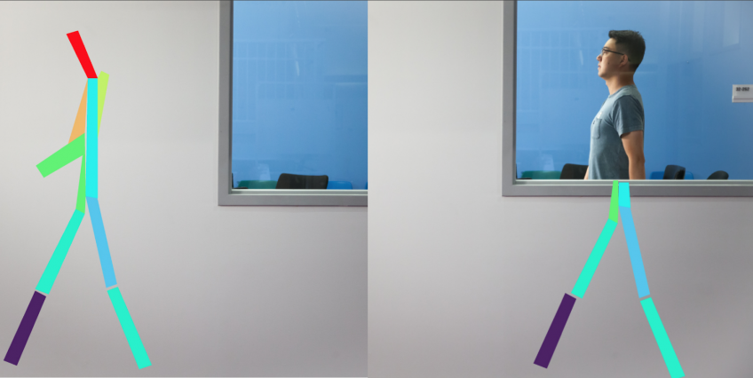
RF-Pose

Slide 14
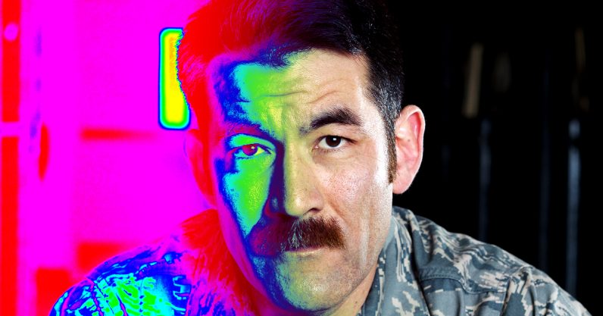
Recognize faces in the dark and through walls

Slide 15
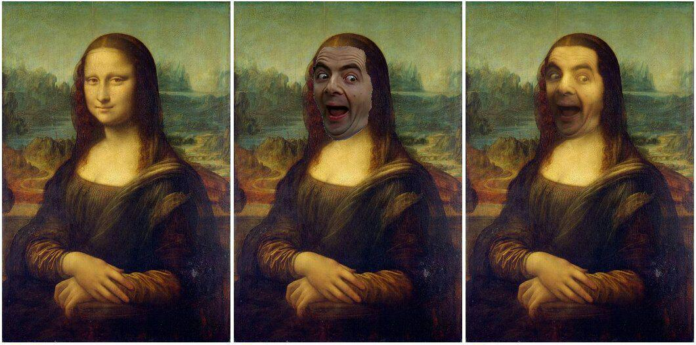
Deep Painterly Harmonization

Slide 16
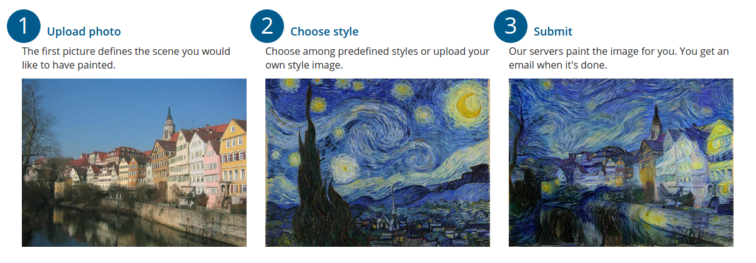
Style Transfer

Slide 17
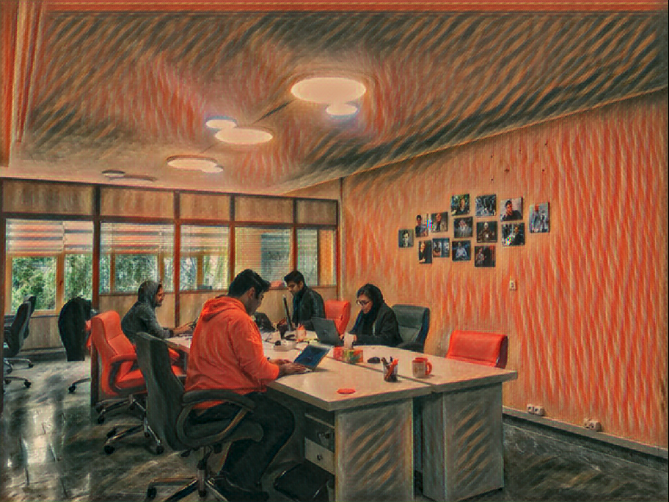
Style Transfer

Slide 18
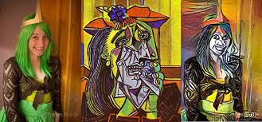
Deep Style

Slide 19
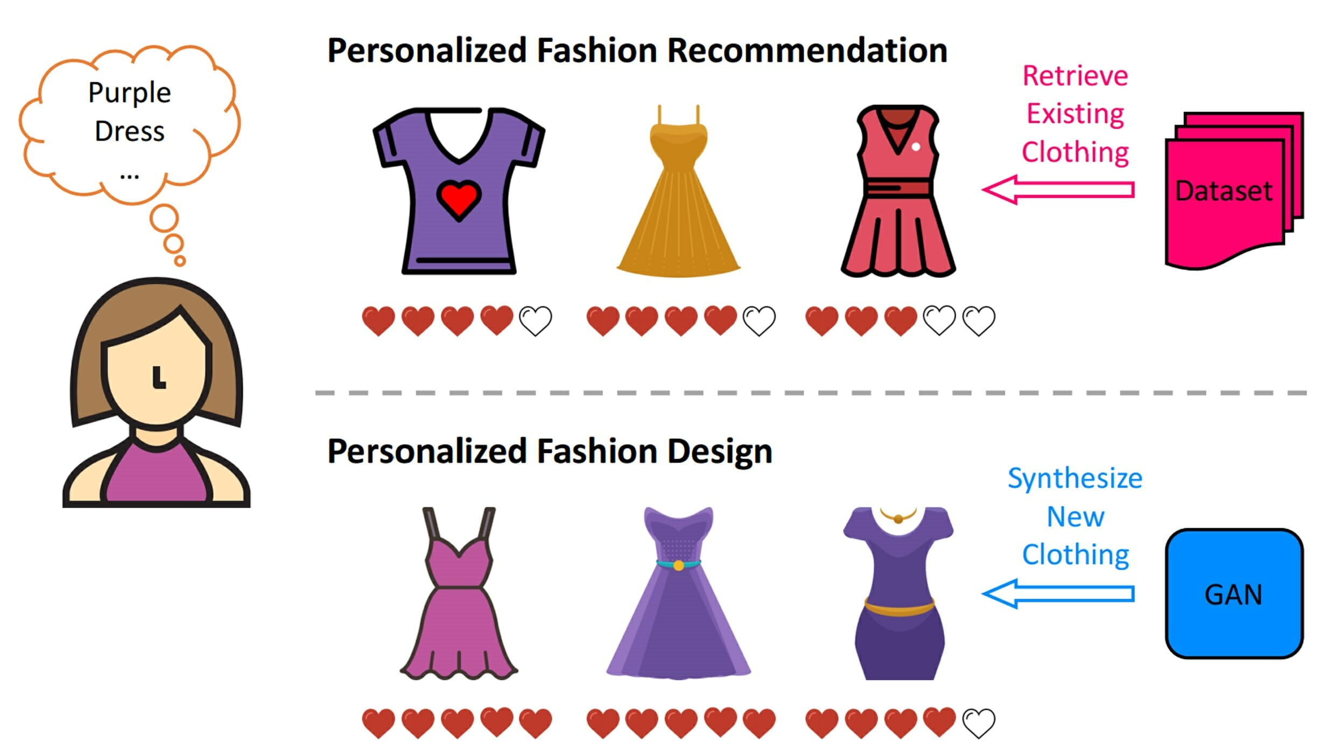
Personalized Fashion Design

Slide 20
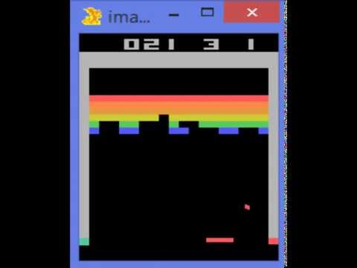
Play ATARI Games

Slide 21
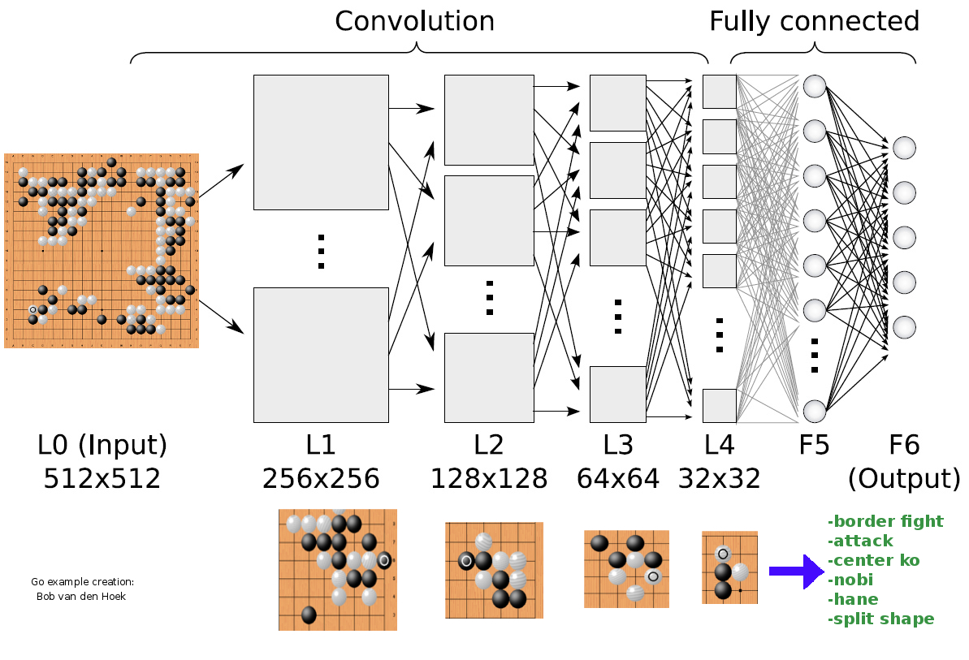
Play Board Games

Slide 22
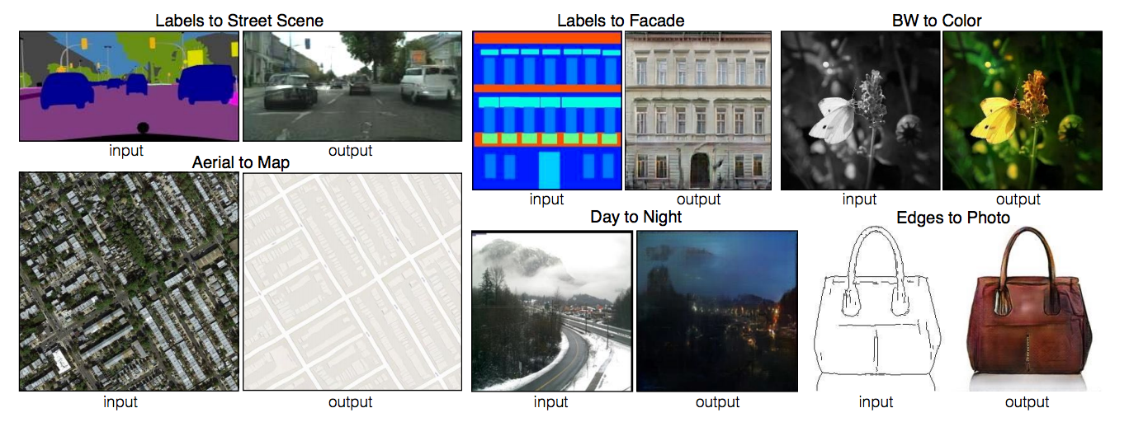
Image Generation

Slide 23
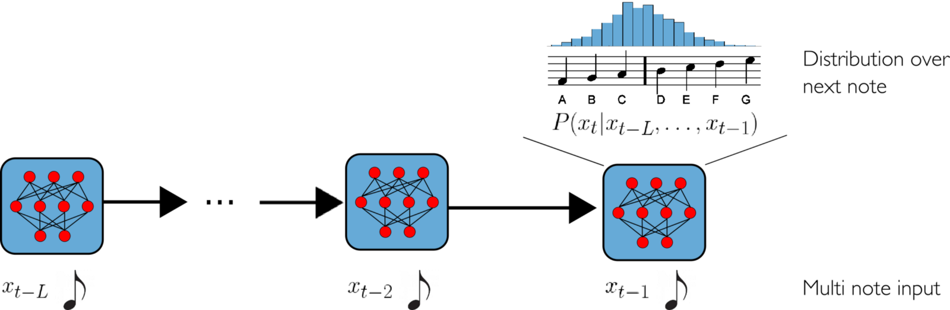
Music Generation

Slide 24
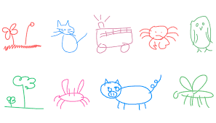
Drawing

Slide 25
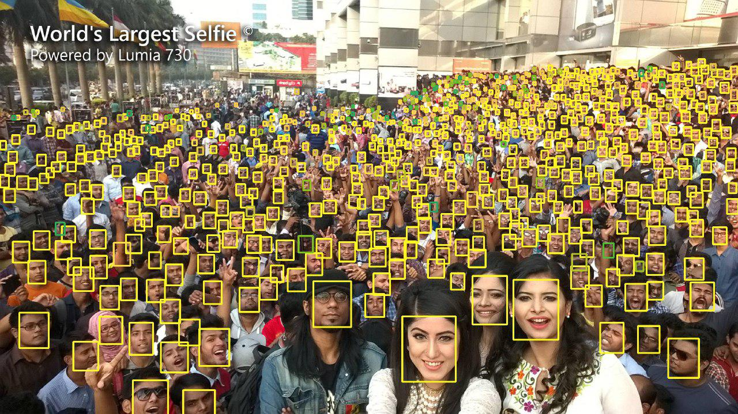
Finding Tiny Faces

Slide 26
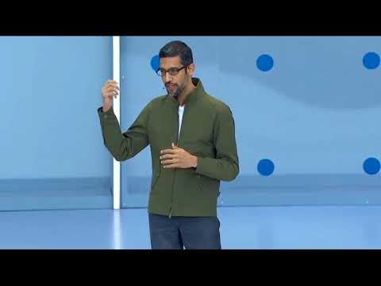
Google Duplex

Slide 27
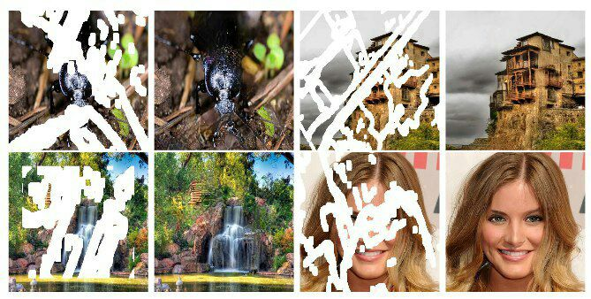
Image Inpainting

Slide 28
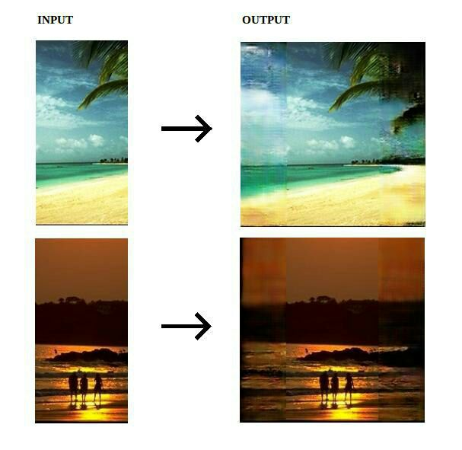
Image Outpainting

Slide 29
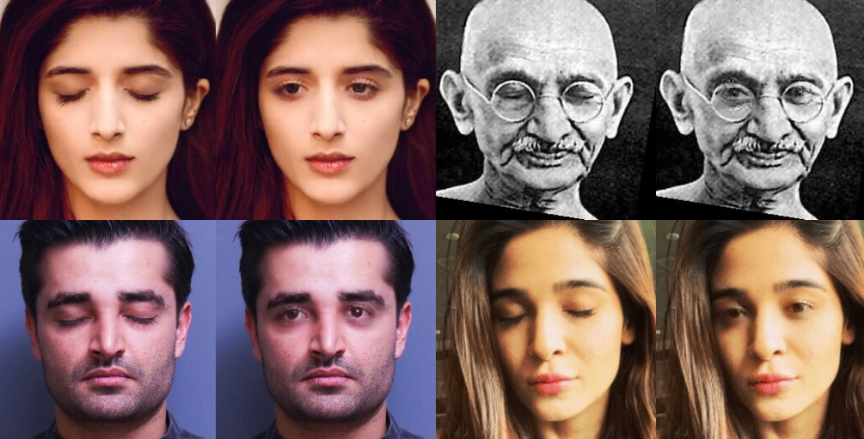
Eye-opener

Slide 30
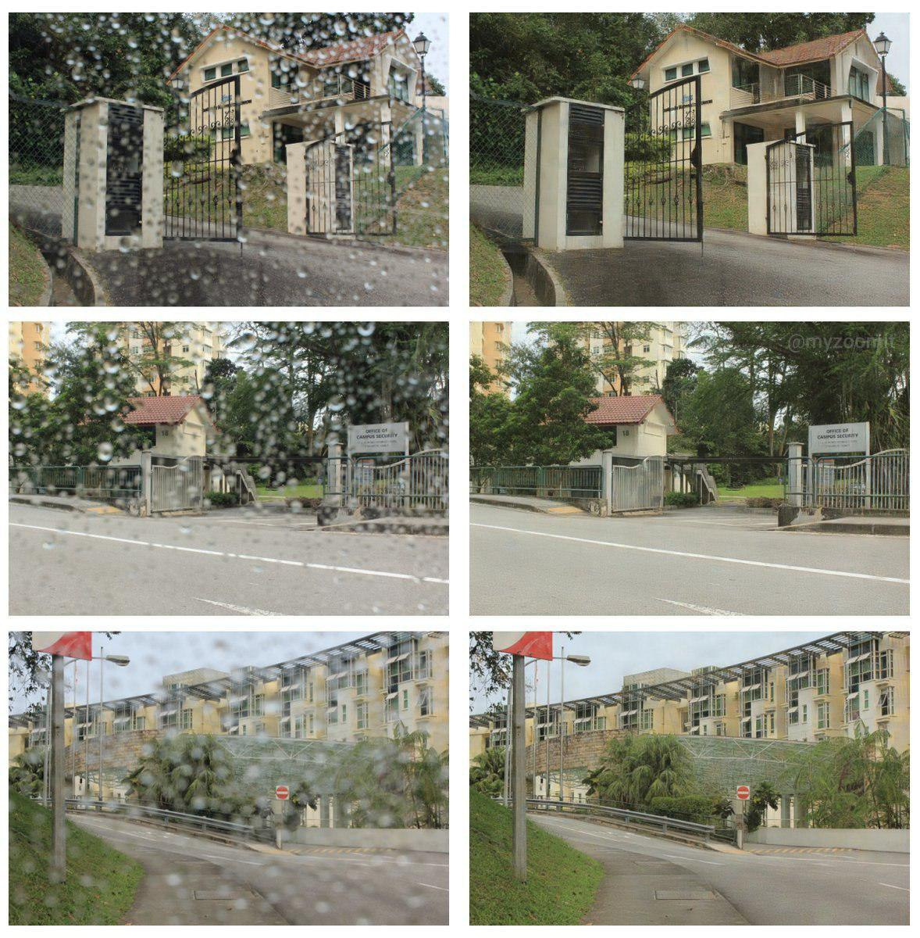
Raindrop Removal from a Single Image

Slide 31
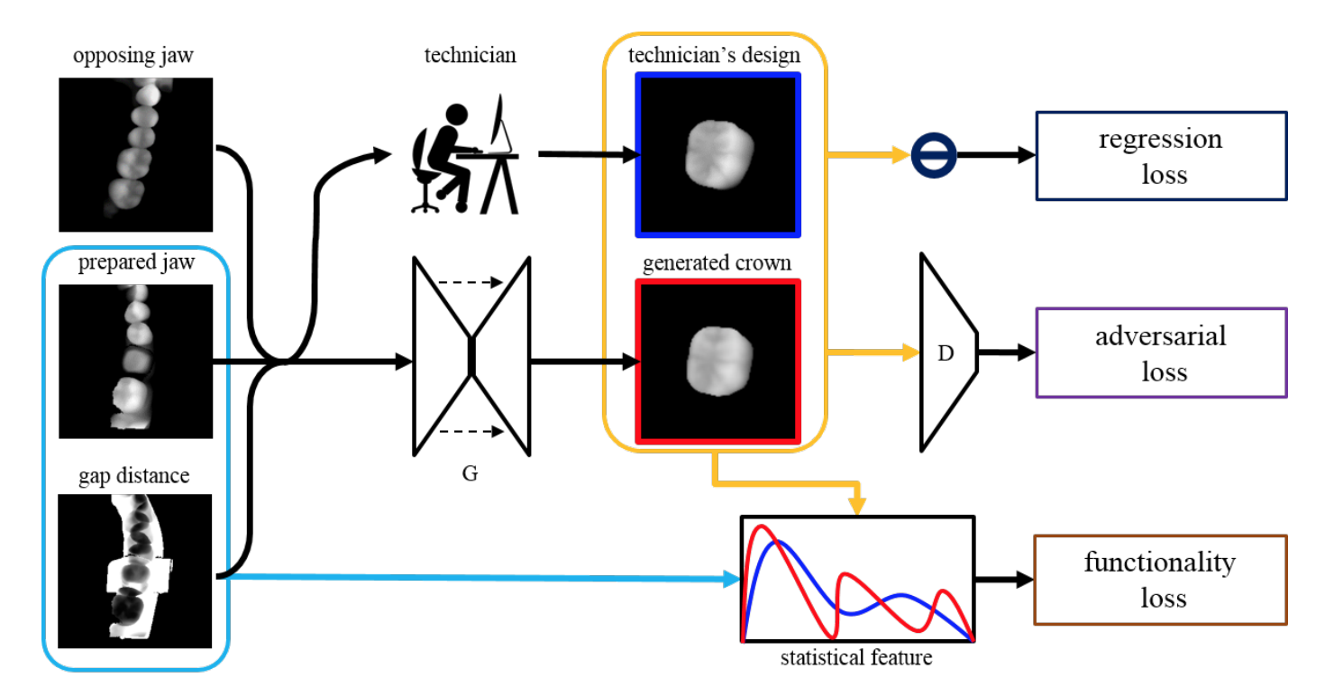
Design Dental Crowns

Slide 32
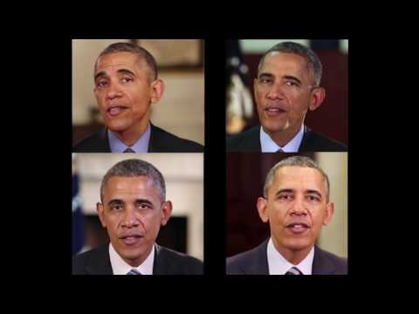
Learning Lip Sync from Audio

Slide 33
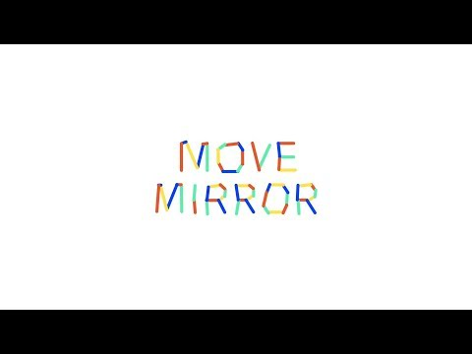
Move Mirror

Slide 34
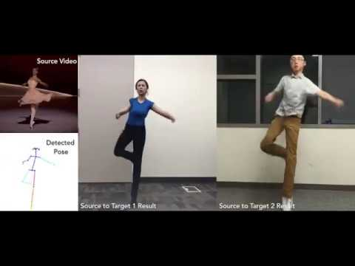
Everybody dance now!

Slide 35
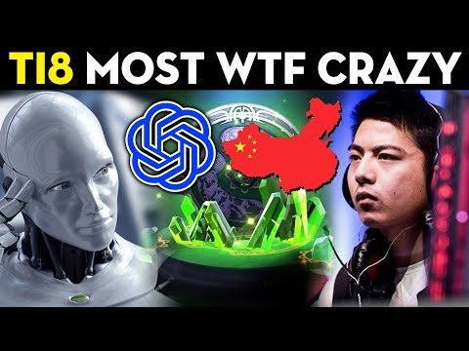
Play Dota 2

Slide 36
Thank You!

